Slide 1
Why are they shooting at my Pickup?
Confidence and clutter in the battlefield
Martin Hill
British Army, Cranfield (Defence Academy), Capgemini
Notes:
[1 min] Quick introduction to me: three hats, British Army, Cranfield (Defence Academy) researcher, Capgemini analytics
PAUSE
My research topic is in distrubuting knowledge across poorly connected communities (in order to support decision making). Tactical operations - forward of the company. Cranfield PhD, British Army as a test bed, Capgemini for the pay (and BI)
PAUSE
Introduce a problem, a real specific problem that generalises, some ideal solutions, some problems with them, and things we might do in training and simulation to help people reduce its effect and frequency
PAUSE
Training and simulation in order to assess information/support decisions in order to improve outcomes (for a dodgy meaning of improve) and feedback/

Slide 2
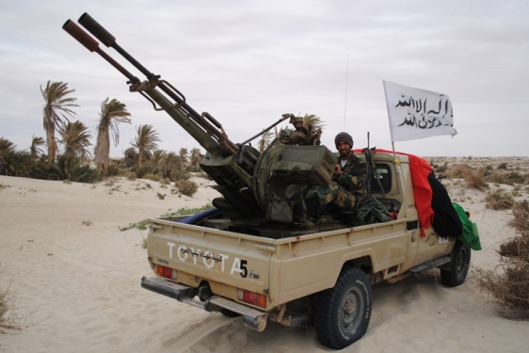
‘Technical’
Notes:
Technical – a pickup with some kind of armament mounted on the back. Not armoured, not expensive, just need a welding shop and enough know-how not to have it collapse under the recoil, if any…

Slide 3
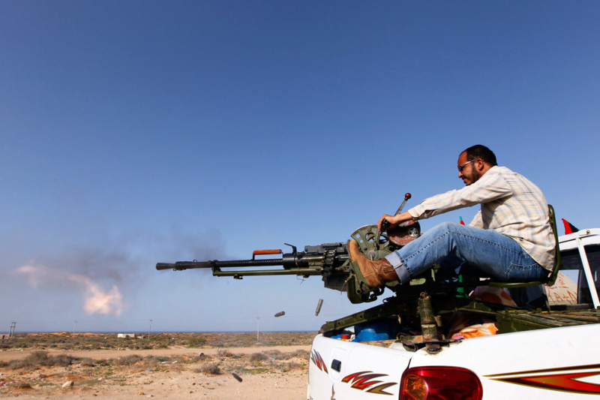
‘Technical’
Notes:
Lighter version..
An aside: The Toyoto Horde (Clive Owen): cheap, fast. If you want to take over the world, a reasonably cheap way of assembling the hardware is a few hundred toyota pickups with missiles, rockets, and bullet launchers. You will still need a natty tailor for your uniforms.
Not to labour it; a force like this does not last long in open ground against modern combined force army, but it is a combined complex force with high mobility, easily crossing AOR/AOI boundaries, creating surprise. Cheap, disguised, fast, and (possibly) limited by weaponry rather than armour.
What might not be a technical – when it might not be.

Slide 4
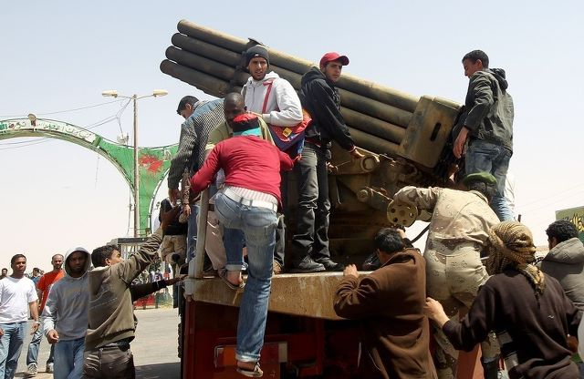
‘Technical’
Notes:
Bigger versions. Sometimes just a bunch of blokes with small arms in a minibus.
Variety of shapes and capabilities and tasks.

Slide 5
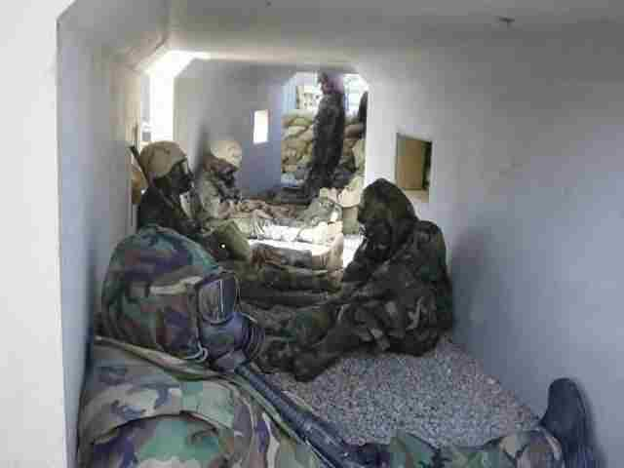
The HQ: What can we see?
Notes:
Meanwhile, back at base, analysts and most commanders do not see the ground; they rely on reports of what happens.

Slide 6
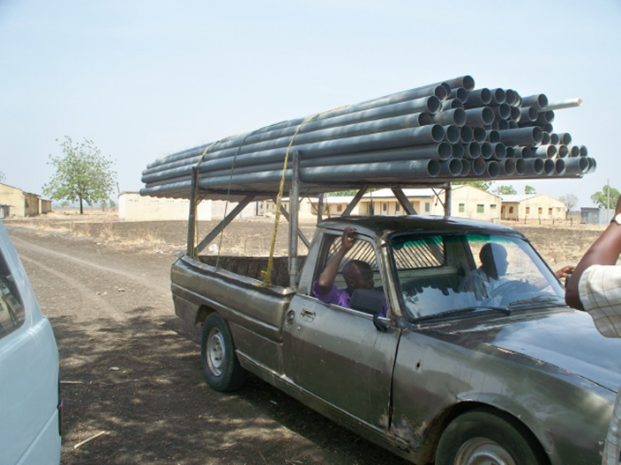
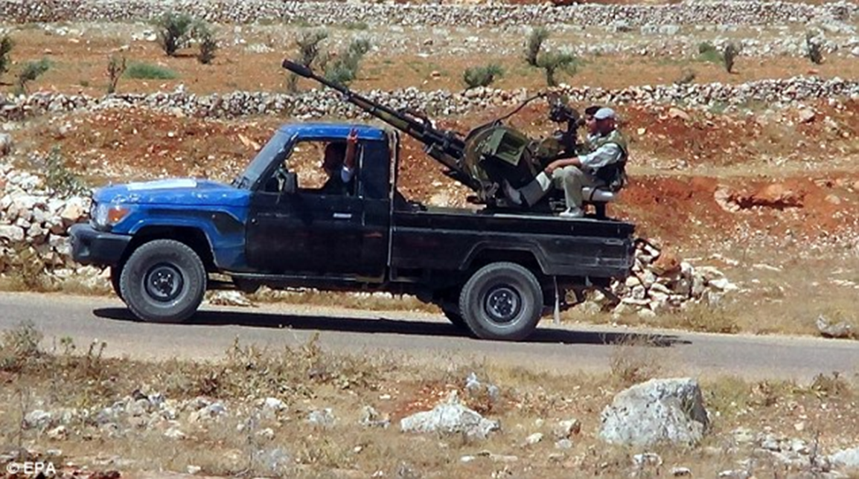
Reports of a ‘Technical’
Notes:
So let’s consider a set of reports received at HQ of a ‘technical’ in the local town.
What the reports might correspond to:
Three reports in your hand. Might be three technicals in town.
[Test audience is awake: “what else?”]
* Several technicals seen in the town; a significant threat.
* One technical seen several times; confirming. Smaller threat, but confirmed.
* One technical seen once and reported several times (civilian, local national forces, our own liaison officer, reported to a patrol, reported at the gate, etc) - known as data incest. Good data sex should avoid incest.
* No technical – a pickup with some pipes
* Something else – things we don’t know we don’t know.

Slide 7
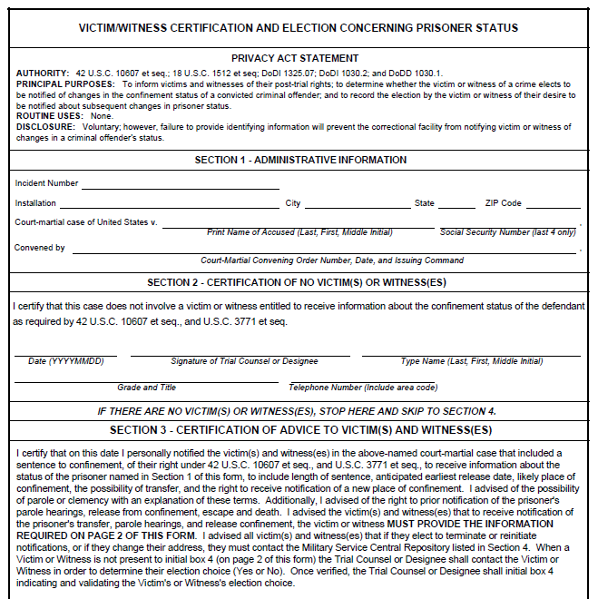
Fixing it… or not…
Provenance:
  Who, where, when, what, what...
  …mark up presence…
  ...and absence!
Express uncertainty and confidence
  “I am highly confident that it is unlikely that…”
  “I am somewhat confident that it is likely that...”
Notes:
[10 mins] The ideal ‘mechanical’ solutions, and why they don’t work very well
Provenance is about describing where it came from. Where, when, who saw it, what is it, what is it doing, etc.
Use forms & drills and mnemonics as checklists, help to avoid missing items.
But forms distract: filling in distracts from situation awareness, and answering a set of given questions can distract from thinking about what questions *should* be being asked on the spot.
Marrying up reports (data fusion) tells us what is the same, what is probably/possibly not the same (different times and locations), and what is not known. The Donald Rumsfeld.
Data audit trail
Hard to fix it – don’t have control over all the information routes. Aside: Allen Dulles (craft of intelligence) – Russians placing tidbits in different embassies so that they arrive at the USA as if they were confirming reports, losing provenance
Even if you have all the information, doesn’t solve it; several reports at different times can still be the same pickup in different places.
The language of confidence, as well as the language of uncertainty. Friedman paper

Slide 8

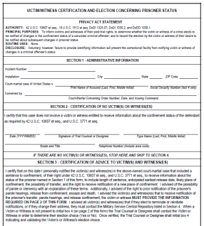
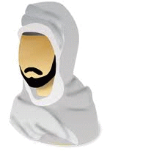
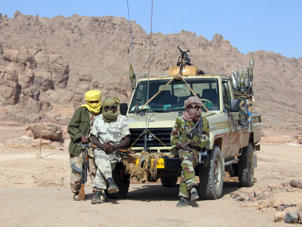


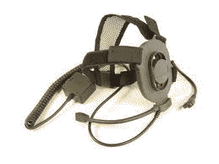
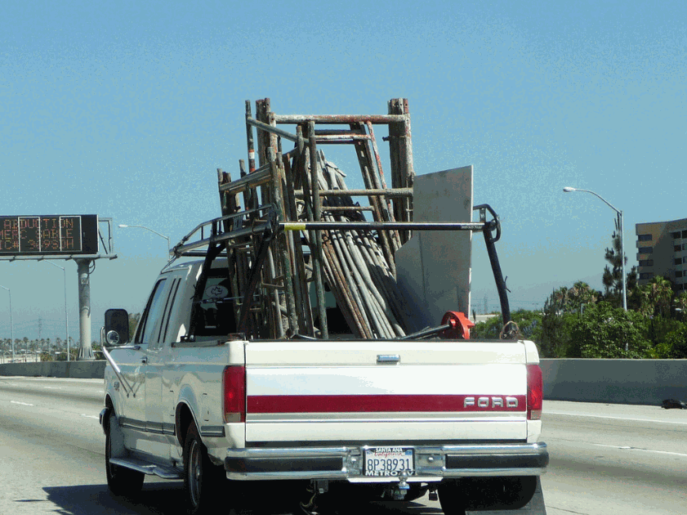
Information Lurch
Notes:
Information does not flow: tag and assess and forward
It gets processed at each thinking node; and it gets garbled and re-formed/shaped at each communication node
Good strong context & background
Fits appropriately; things that surprise should surprise, things that ‘fit’ should be expected

Slide 9
Acceptable failure
Update rates
Go and have a look
Acceptable false positives, negatives
Notes:
Update rates – how quickly do you need to know, when do you expect to get your next report in, what
→ Update cycle; looks like a force, recce with force (rather than bomb remotely) --> it's not, leave alone --> update TTPs
→ Acceptable decision failure rates, update rates.

Slide 10

Training & Simulation
Neat & Tidy
Dirty Data:
  Cluttered
  Incomplete
  Unreliable
Drills & Skills → Understand → Exploit
Scooby Doo
Miss Marple
Sherlock Holmes
Sam Spade
Impossible
Notes:
Training and simulation for these situations, requires a situation picture that is:
Cluttered
Incomplete
Unreliable
Clutter: many other events and items with similar characteristics. Camouflage → phone calls, sightings, reports. ‘Normalised’ events – eg rocks being thrown then grenades. Not seeing the wood for the trees. Busy
Incompleteness: Partial reports. Difficult radio comms. Ambiguous directions/locations.
Unreliable: false cues. Lies. Misinterpretations – mistranslations.. Chinese whispers.
More than simple easy-to-follow
→ Developing drills & skills to understand the situation, but also exploit it. Act ahead of other actors. Surprise rather than be surprised.
→ Slider – early stages vs later stages. SI units

Slide 11
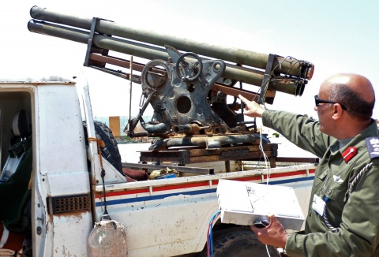
Summary
Fusion ambiguity is likely...
...can be reduced...
...and mitigated...
...(and accepted)
When training:
Add Clutter
Remove Clues
Lie

